Slide 1

Project Title - Seasonal Agriculture Performance Analysis
Student name - Shreyash Jha
College Name - K.R Mangalam University
AICTE STU ID : STU68b2a6766894b1756538486

Slide 2

PROBLEM STATEMENT
Agricultural activities are influenced by seasonal variations in environmental conditions, farming practices, resource availability and market conditions. As a result, agricultural performance may differ from one season to another. However, raw agricultural data does not clearly explain how agricultural performance changes across seasons or what patterns can be observed in different seasonal conditions. The problem is to analyse the given agricultural dataset and investigate seasonal differences in agricultural performance by identifying meaningful patterns, trends, relationships and variations within the available data.

Slide 3
Project Description Overview: This project analyses agricultural performance across different seasons using Python (Pandas, Seaborn, Matplotlib) in Jupyter Notebook. It provides insights into yield, production, and environmental factors to support data‑driven agricultural planning. Key Points: Dataset includes rainfall, temperature, humidity, soil, irrigation, fertilizer, yield, and production Covers 8 phases: Data Cleaning → EDA → Seasonal Analysis → Relationships → Insights → Conclusions → Documentation Visualizations: barplots, lineplots, scatterplots, heatmaps for clear trend analysis Identifies correlations between environmental factors and crop yield/production Provides actionable recommendations for efficient resource use and planning

Slide 4

WHO ARE THE END USERS?
Farmers & Growers → to plan crops, irrigation, and fertilizer use based on seasonal trends.
Agricultural Planners & Policy Makers → to design strategies for resource allocation and food security.
Agri‑business Companies → to optimize production, supply chains, and market pricing.
Researchers & Data Analysts → to study correlations between environmental factors and yield.
Educational Institutions → to use the project as a case study in data visualization and agricultural analytics.

Slide 5

Technology Used
Programming Language: Python
Libraries: Pandas, Seaborn, Matplotlib
Environment: Jupyter Notebook
Tools: VS Code, Anaconda
Data Handling: Cleaning, preprocessing, correlation analysis
Visualization: Barplots, lineplots, scatterplots, heatmaps

Slide 6
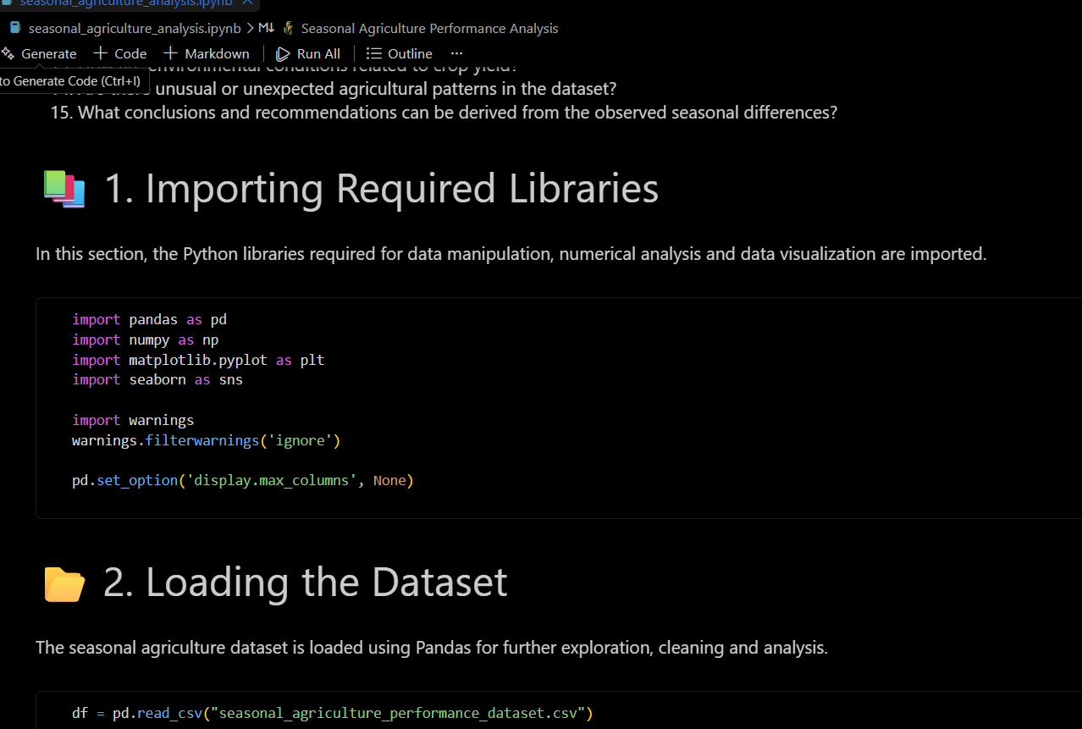
RESULTS
Importing required libraries and loading the dataset.

Slide 7
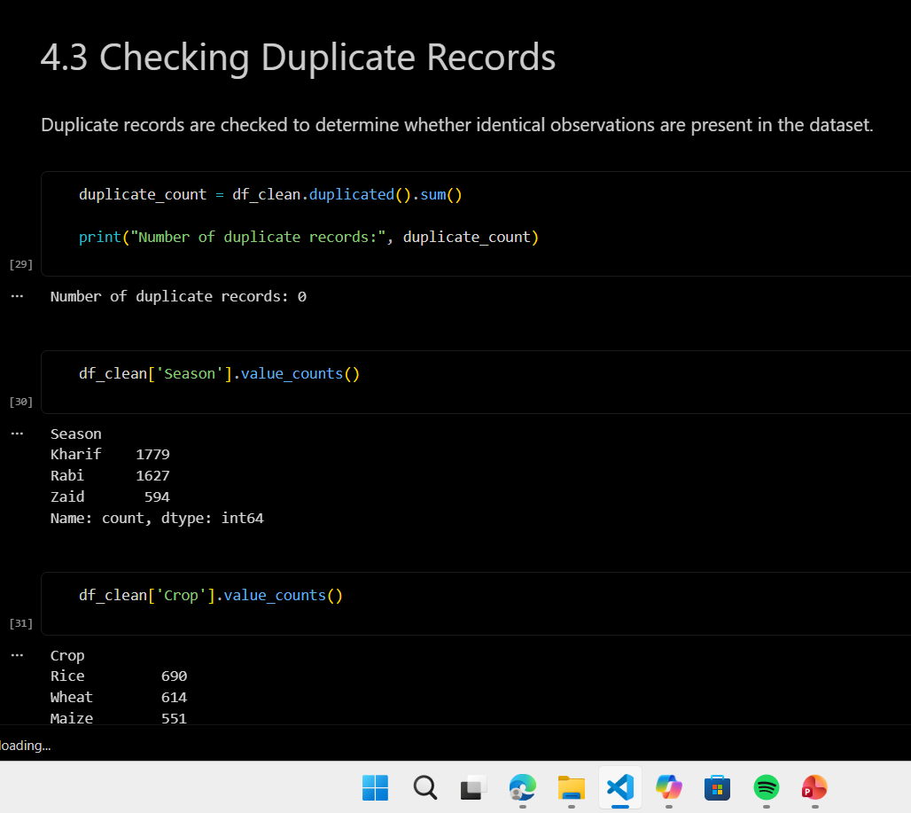
RESULTS
Duplicate records are checked to determine whether identical observations are present in the dataset.

Slide 8
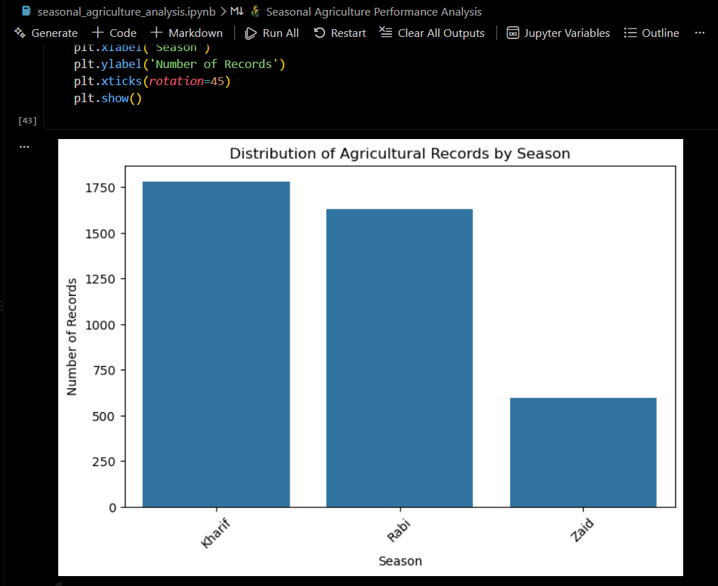
RESULTS

Slide 9
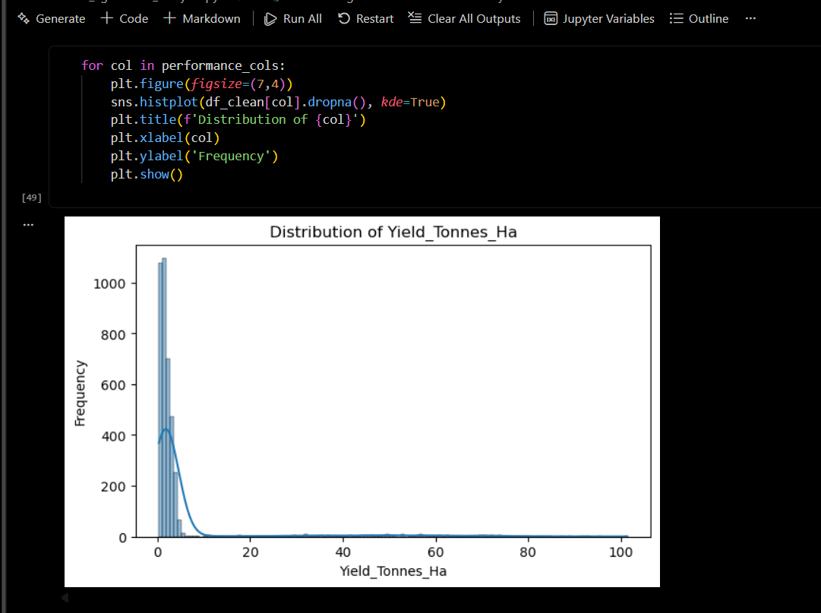
RESULTS

Slide 10
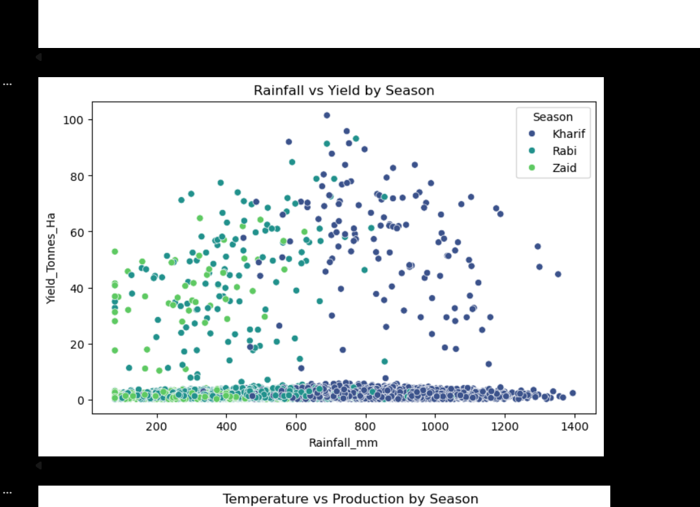
RESULTS

Slide 11
Future scope
Integration with Real‑time Data: Connect to live weather and rainfall APIs for dynamic predictions.
Machine Learning Models: Build predictive models for yield forecasting and risk analysis.
Scalability: Extend analysis to larger datasets across multiple regions and crop types.
Decision Support Systems: Develop dashboards for farmers and policymakers to make data‑driven decisions.
IoT & Sensors: Incorporate soil moisture, temperature, and humidity sensors for precision agriculture.
Cloud Deployment: Host the solution on platforms like AWS/Azure for accessibility and collaboration.

Slide 12
GitHub Link
https://github.com/Shreyashjha1/VOIS_Data_Analyst_Major-Project.git

Slide 13
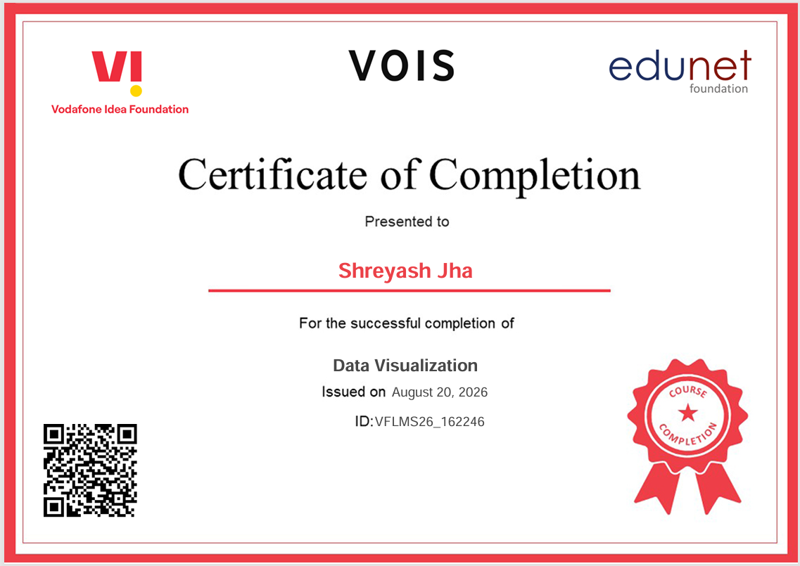
VOIS Course completion certificate - Course name- Data Visualization

Slide 14
Thank you
Thank You
.
.

